Slide 1
ASP.NET Core 3 in 7 Days
Burdett Wilson
Notes:
[Mandatory Slide] This would be the introduction slide of the topic that you are covering in this subsection.
When this slide plays, you could talk about the main aim that we’d be covering in this video.

Slide 2
DAY ONE – GETTING STARTED WITH .NET CORE

Slide 3
Discovering the .NET CORE philosophy
Day One – Video One
Notes:
[Mandatory Slide] This would be the introduction slide of the topic that you are covering in this section.
When this slide plays, you could talk about the main aim that we’d be covering in this section.

Slide 4
What is .NET Core ?
.NET Core 3 Framework operates in three fields:
Client / User Facing
Logic/Business Object
Data Object

Slide 5
What We’ll Learn?
Video One
Video Three
Video Five
Video Two
Video Four
Discovering the .NET Core philosophy
Migrating to .NET Core
Writing a “hello world” program
Understanding Kestrel and IIS
Installing the Different tools

Slide 6
Why Use ASP.NET Core 3?
Model-View-Controller (MVC)
Cloud and Internet Ready
Razor Pages
Tag Helpers
Multiple Data Formats
Designed For Testing
Because you need to build modern API and Web Based UI quickly with Modern Architecture.

Slide 7
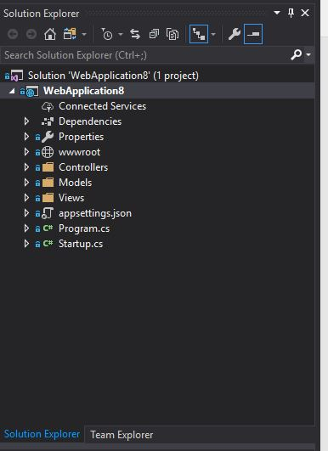
ASP.Net Core 3
Client
Logic / Business
Data
Modern Archetecture for your projects
Notes:
Like mentioned – best for flowcharts, block diagram, and images in the split-view of course!

Slide 8
ASP.NET Core is a Full Stack development environment

Slide 9
What makes Net Core 3 popular ?
Integration of modern, client-side frameworks and development workflows.
A cloud-ready, environment-based configuration system
Built-in dependency injection.
A lightweight, high-performance, and modular HTTP request pipeline.
Razor Pages makes coding page-focused scenarios easier and more productive.
Architected for testability.

Slide 10
Understanding Kestrel and IIS
Next Video 1.2
Notes:
[Mandatory Slide] This would be the slide of the next video that you will be covering.
When this slide plays, you could talk about the main aim that we’d be covering in the next video.

